Slide 1
Public Group Meeting (7/9/24)
Somdeepa Das

Slide 2
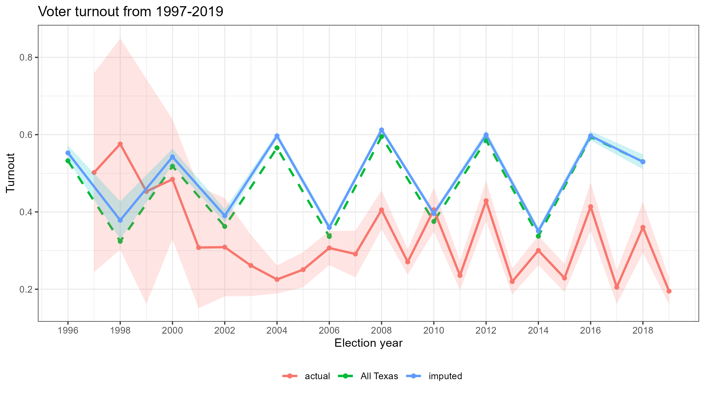
Election turnout over time

Slide 3
Odd vs even elections
 | Even Year | Odd Year
Total | 491 | 408
Proportion passed | 0.815 | 0.816
Average Turnout | 0.353 (0.0186) | 0.253 (0.0161)
Average For Vote share | 0.621 (0.0117) | 0.619 (0.0134)
 | Even Year | Odd Year
Beer & Wine Off-Premises | 0.34 | 0.32
Mixed Beverages in Restaurants | 0.26 | 0.21
All Alcoholic Beverages | 0.18 | 0.22
All Alcoholic Beverages Off-Premises | 0.15 | 0.19
Beer & Wine | 0.04 | 0.04
- More elections in even years, however no significant differences in how people vote in these years
- There are also no significant differences in the type of issues being brought to the ballot

Slide 4
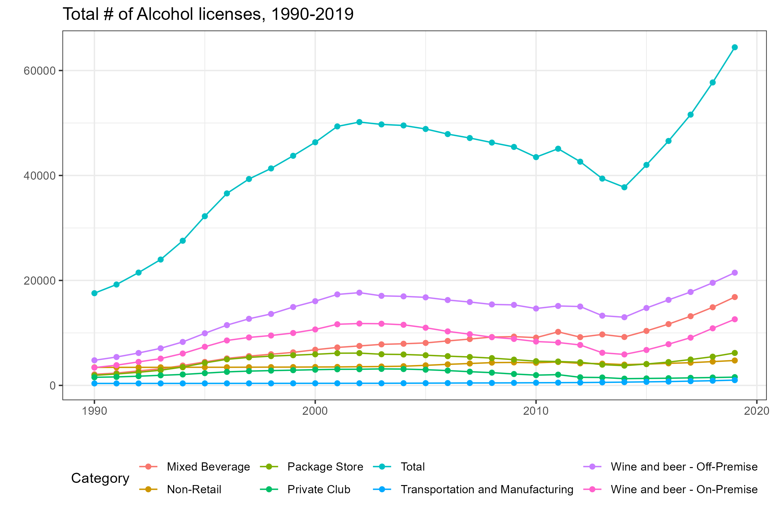
Alcohol licenses in Texas

Slide 5
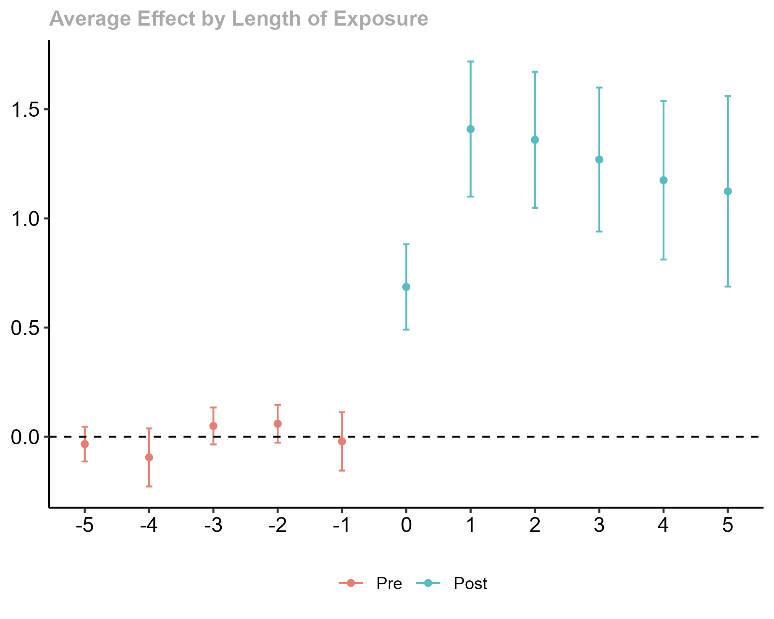
Alcohol licenses – event study

